Slide 1
CSC 211/212
DATA STRUCTURES AND ALGORITHM

Slide 2
GROUP WORK
PRESENTATION
GROUP NO. 6

Slide 3
What is AVL Tree?
Is defined as the height balanced binary search tree (BST) in which each node is associated with balancing factor which is calculated by subtracting the height of its right sub-tree from that of its left sub-tree.

Slide 4
AVL Tree cont...
Tree is said to be balanced if balance factor of each node is between -1 to 1, otherwise, the tree will be unbalanced and need to be balanced (by using AVL rotation)
Balance factor (BF) formula is given as:
BF=Height(left sub-tree) – Height(right sub-tree)

Slide 5
NOTE:
If BF of any node is 1, it means that left sub-tree is one level higher than the right sub-tree
If BF of any node is 0, it means that left sub-tree and right sub-tree contain equal height
If BF of any node is -1, it means that left sub-tree is one level lower than the right sub-tree

Slide 6
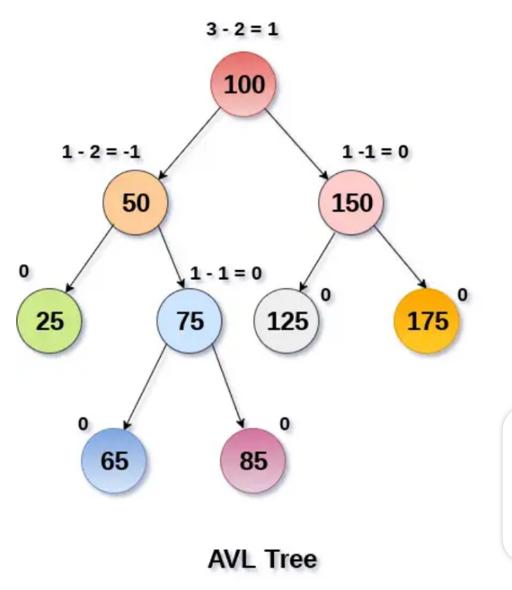
Example of balanced AVL tree

Slide 7
CONCEPT OF AVL ROTATIONS
(performed if AVL tree is not balanced)
There are four types of AVL rotations:
LL rotation
RR rotation
LR rotation
RL rotation
NOTE:
LL and RR are called single rotation.
LR and RL are called double rotation.

Slide 8
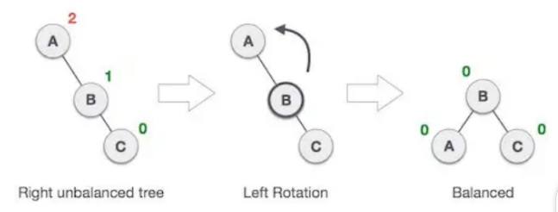
RR ROTATION
When BST become unbalanced due to a node inserted into the right sub-tree of the right sub-tree of let say node A, then we perform RR rotation. RR rotation is an anticlockwise rotation applied on the edge below a node having unbalanced factor.

Slide 9
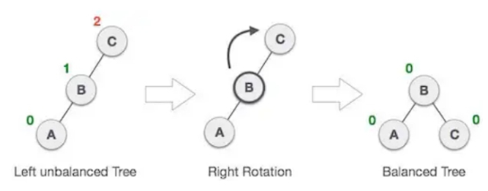
LL ROTATION
When BST become unbalanced due to a node inserted into the left sub-tree of the left sub-tree of let say node C, then we perform LL rotation. LL rotation is an clockwise rotation applied on the edge below a node having unbalanced factor.

Slide 10
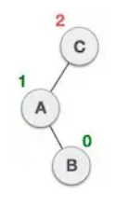
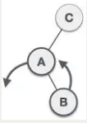
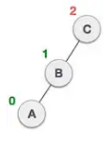
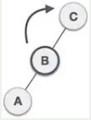
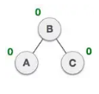
LR ROTATION
Is a double rotation which start with RR rotation followed by LL rotation of unbalanced factor due to node inserted in the right sub-tree of the left sub-tree of C.
i.e. LR rotation = (Combination) of RR rotation + LL rotation

Slide 11
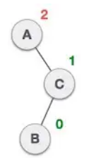
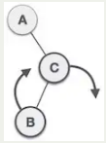
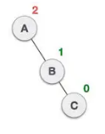
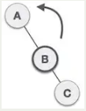
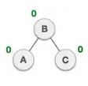
RL ROTATION
Is a double rotation which start with LL rotation followed by RR rotation of unbalanced factor due to node inserted in the left sub-tree of the right sub-tree of A.
i.e. RL rotation = (Combination) of LL rotation + RR rotation

Slide 12
Why learn AVL Tree?
Because it is mostly used for in memory sorts of sets and dictionaries
Because it is also used extensively in database applications
Because it is used in applications that required improved searching apart from the database application

Slide 13
AVL Tree Common operations
The following are common operations in AVL tree:
Create
Traverse
Search
Inserting
Deleting

Slide 14
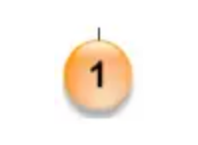
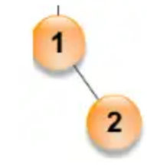
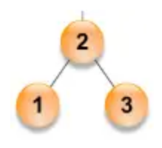
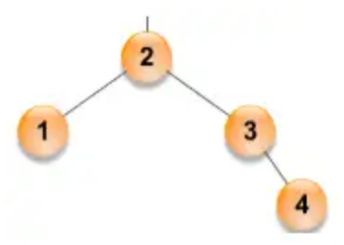
1. Create AVL tree (with node values: 1,2,3,4,8,7,6)
Step 1:
Write 1 as root and balance
Step 2:
Write 2 in right side of 1 and balance
(2>root)
Step 3:
Write 3 in right side of 2 and balance
(3>root && 3>2)
Step 4:
Write 4 in right side of 3 and balance
(4>root && 4>3)

Slide 15
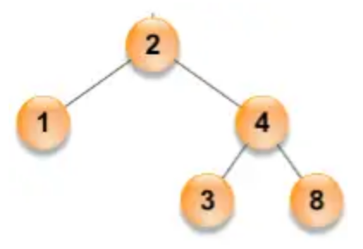
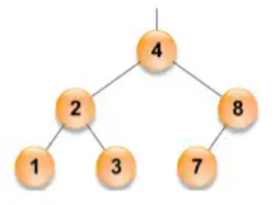
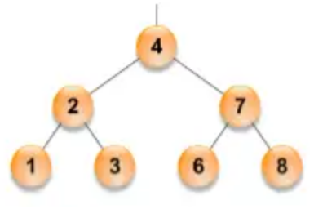
1. Create AVL tree… (with node values: 1,2,3,4,8,7,6)
Step 5:
Write 8 to the right of 4 and balance
(8>root && 8>4)
Step 6:
Write 7 to left of 8 and balance
(7>root && 7<8)
Step 7:
Write 6 to the left of 7 and balance
(6>root && 6<7)

Slide 16
2. Traverse AVL tree
Traverse is a process to visit all the nodes of a tree and may print their values too
Ways of traversal
a) In-order traversal
b) Pre-order traversal
c) Post-order traversal

Slide 17
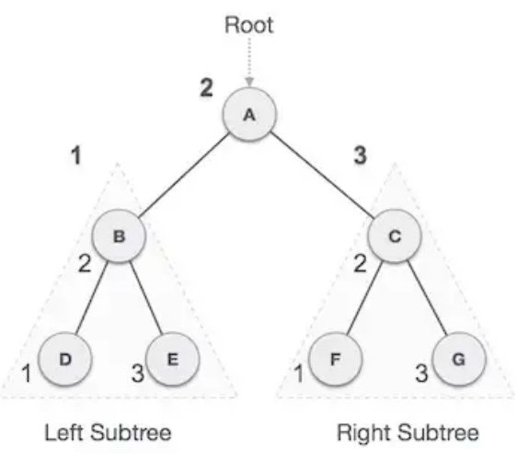
In-order traversal
In this method, the left sub-tree is visited first, then the root and later the right sub-tree
The output of in-order traversal of the tree will be;
D – B – E – A – F – C – G

Slide 18
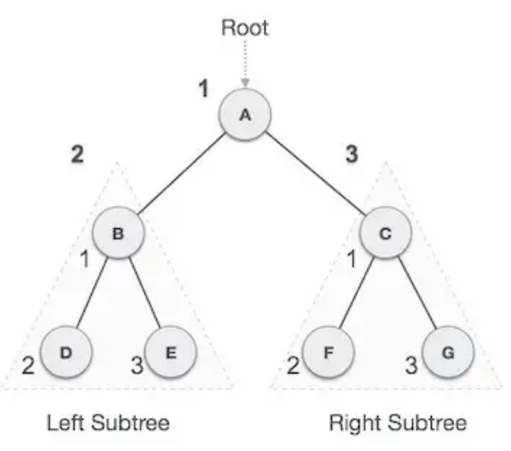
Pre-order traversal
In this traverse method, the root node is visited first, then the left sub-tree and finally the right sub-tree
The output of pre-order traversal of the tree will be;
A – B – D – E – C – F – G

Slide 19
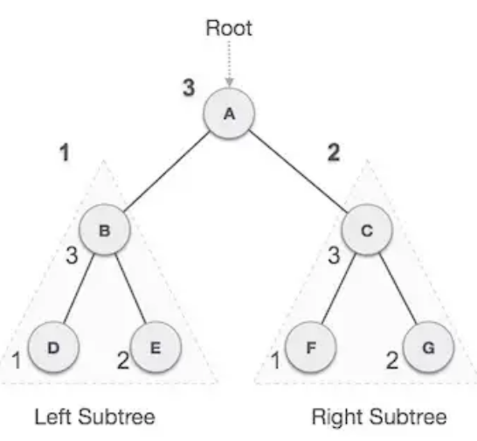
Post-order traversal
In this traverse method, first we traverse the left sub-tree, then right sub-tree and finally root node
The output of post-order traversal of the tree will be;
D – E – B – F – G – C – A

Slide 20
3. Search node in AVL tree
To search an element in the AVL tree there are steps to follow
First read the element provided by the user say x
Compare x with the root element, if it is the same, then exit otherwise go to the next step
If x<root element, go to the left child and compare else go to the right child and compare again

Slide 21
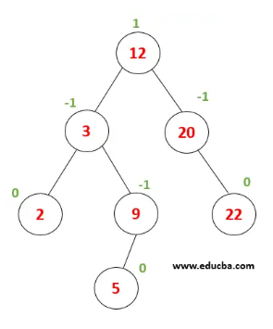
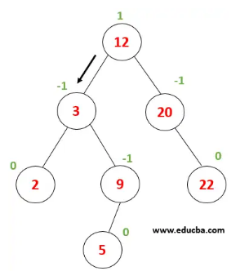
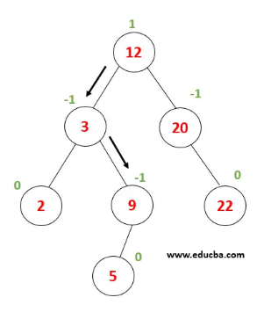
Example: Search for node with value of say x=9
Compare x with root node since (X<12) then go to the left
Compare x with 3 node since (X>3) then go to the right
Compare x with 9 node since (X=9) then print and exit

Slide 22
4. Insert node in AVL tree
When inserting an element in the AVL tree we need to find location particular element that needs to be inserted and attach the value
Then check if the tree is balance i.e. BF<=1 and if the tree become unbalanced perform AVL rotations

Slide 23
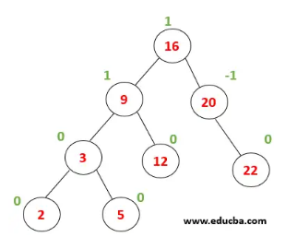
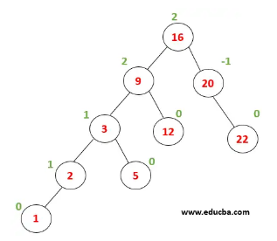
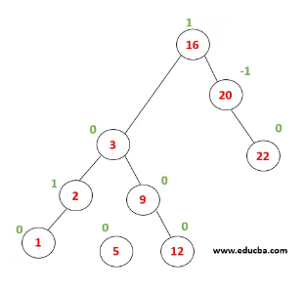
Example: Insert node with value of 1
Traverse the tree to find location to insert i.e. 1<2 the left child of 2
After inserting 1 node (9) become unbalanced then perform LL rotation to balance tree
A tree become
balanced after right rotation hence operation
completely successfully

Slide 24
5. Deletion a node in AVL tree
When deleting an element in the AVL tree, an element is searching and after finding the element, it is removed from the tree and elements are adjusted to make it BST again.
Then check if the tree is balance i.e. BF<=1 and if the tree become unbalanced perform AVL rotations

Slide 25
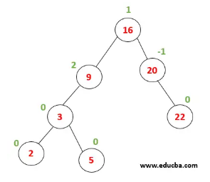
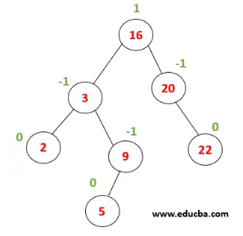
Example: Deleting node with value of 12
Search for the node with the value of 12 to delete
After deleting node with value 12 the node with value 9 become unbalanced with BF=2 and need to be balanced with LL rotation
Then after LL rotation the tree become balanced

Slide 26
Deletion the AVL tree
To delete the entire AVL tree we need to set the root to be null then nodes after root will be delete automatically and the process goes on until the leaf nodes

Slide 27
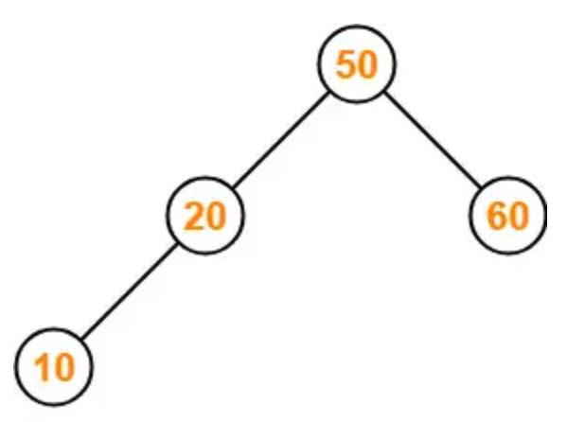
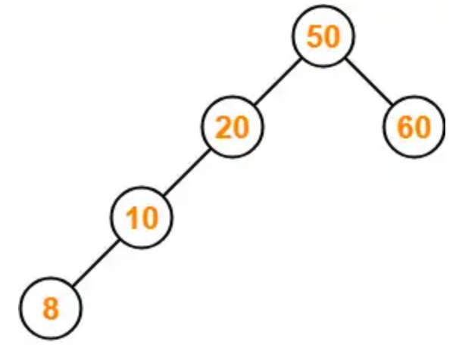
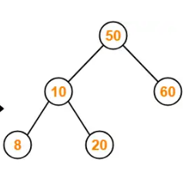
Insert in AVL LL (E.g. insert 8 in LL-AVL tree)
In inserting node to the LL in AVL tree first check where your node value is accepted in the leaf node
Then second check if left insertion of the that node is possible on that leaf node

Slide 28
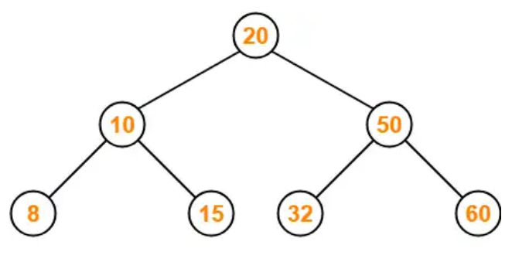
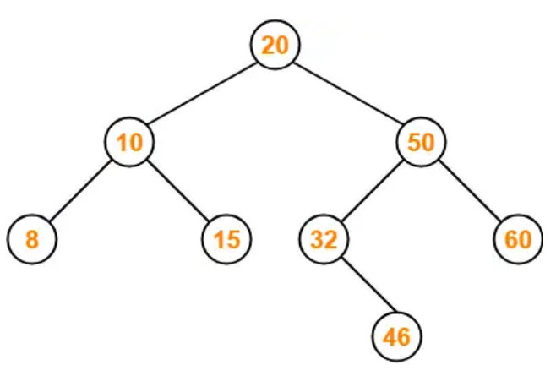
Insert in AVL LR (E.g. insert 46 in LR-AVL tree)
In inserting node to the LR in AVL tree first check where your node value is accepted in the leaf node
Then second check if left insertion of the that node is possible on that leaf node

Slide 29
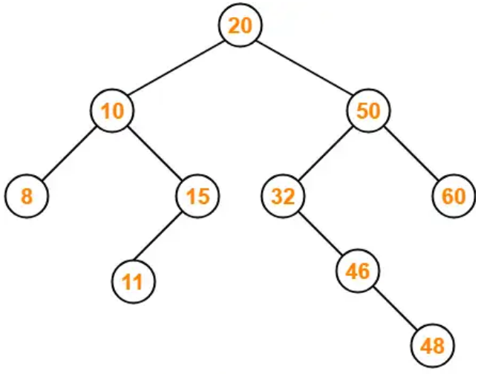
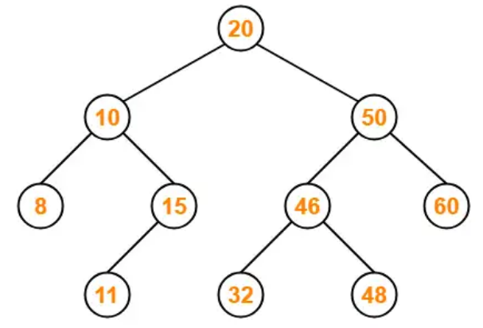
Insert in AVL RR (E.g. insert 48 in RR-AVL tree)
In inserting node to the RR in AVL tree first check where your node value is accepted in the leaf node
Then second check if left insertion of the that node is possible on that leaf node

Slide 30
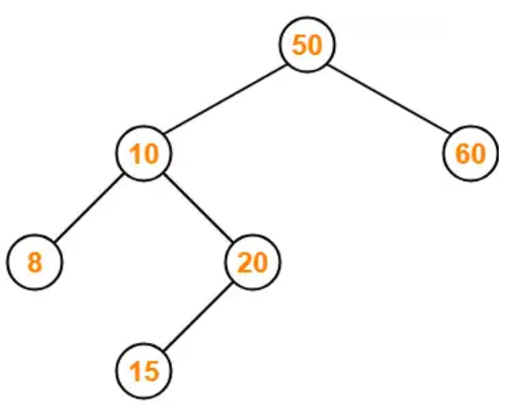
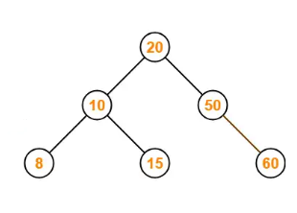
Insert in AVL RL (E.g. insert 15 in RL-AVL tree)
In inserting node to the RR in AVL tree first check where your node value is accepted in the leaf node
Then second check if left insertion of the that node is possible on that leaf node

Slide 31
Insert End to End Case
When inserting nodes in AVL tree with End to End Case you should involve all four AVL Rotations which are:
RR Rotations
LL Rotations
RL Rotations
LR Rotations

Slide 32
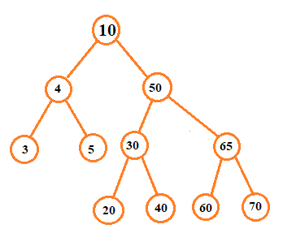
Insert End to End Case…
Example:
Insert the following node values in the AVL trees;
30, 20, 40,10,5,3,4,50,60,70,65
Insertion of the above values lead to the AVL tree as seen on the right side

Slide 33
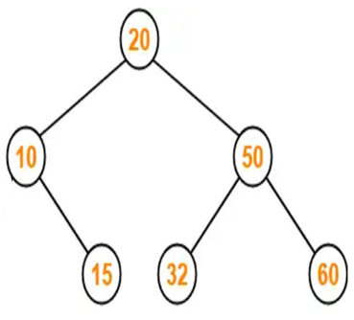
Delete LL LR RR RL
Example of LL Deletion:
Delete 8 in the left of 10 which is in left of 20
After deletion the AVL tree become as below which is balanced

Slide 34
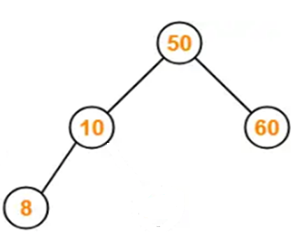
Delete LL LR RR RL
Example of LR Deletion:
Delete 20 in the right of 10 which is in left of 50
After deletion the AVL tree become as below which is balanced

Slide 35
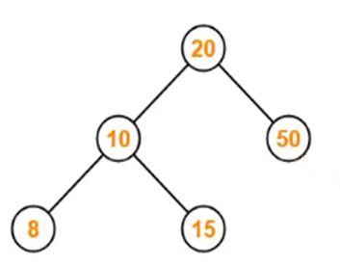
Delete LL LR RR RL
Example of RR Deletion:
Delete 60 in the right of 50 which is in right of 20
After deletion the AVL tree become as below which is balanced

Slide 36
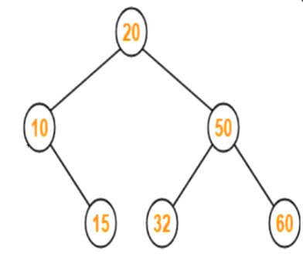
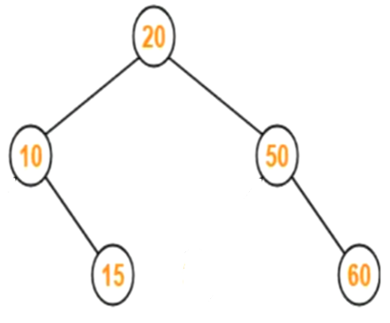
Delete LL LR RR RL
Example of RL Deletion:
Delete 32 in the left of 50 which is in right of 20
After deletion the AVL tree become as below which is balanced

Slide 37
Delete End to End Case
When deleting nodes in AVL tree with End to End Case you should involve all four AVL Rotations which are:
RR Rotations
LL Rotations
RL Rotations
LR Rotations

Slide 38
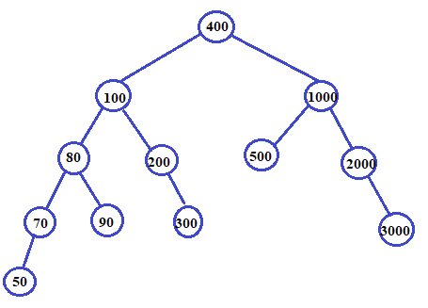
Delete End to End Case…
Example:
Delete the following node values in the AVL trees;
delete 90,50,300,200,500
Insert 2500
Delete 1000

Slide 39
END OF PRESENTATION

Slide 40
THANKS FOR LISTENING.

